Slide 1

Infectious disease modelling course
Jointly organised by LSHTM, Fudan University and HKU under the auspices of NIHR EPIC, 12-14 August 2019
Modeling Smallpox Interventions
Joseph Wu (joewu@hku.hk)

Slide 2


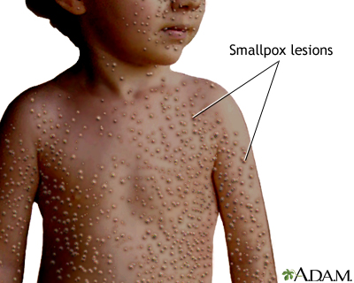
The official 1979 declaration that
"smallpox has been eradicated
from the world“

Slide 3
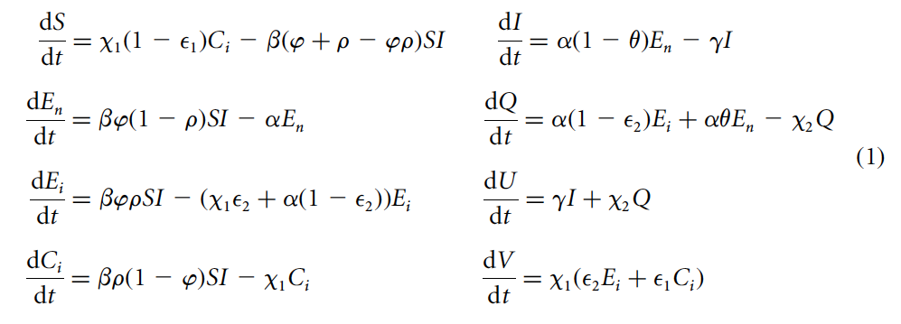
Case tutorial
We will build this model one step at a time starting from the basics.

Slide 4
Transmission history
Transmission routes of smallpox:
Primary route of transmission is through direct face-to-face contact with an infected individual
Historically most cases were in children - long duration of immunity following exposure (estimates up to 20 years or more) although opinions divided
Natural history of smallpox:
Incubation period
Fever (2-3 days)
Rash (7 days)
Death (20-30%)
Pustules (7 days)
Scab lesions
Recovery

Slide 5
SEIR model
λ = force of infection = βφI(t)
β = rate at which “infectious contacts” occur
φ = probability that the “infectious contacts” result in infection
α = rate of latent (E) becoming infectious = 1/(mean latent period)
γ = rate of infectious (I) becoming recovered or dead (U) = 1/(mean infectious period)
S
E
I
U
λ
α
γ
Susceptible Exposed Infectious Removed
State: the boxes Rate: the arrows
Rate of outflow from a state = 1 / Average duration spent in that state

Slide 6
Flow diagram vs equations
The model can be specified using flow diagrams or equations.
Each equation represents a state in the flow diagram
Each term on the right hand side of an equation represents an arrow in the flow diagram
Each term is (rate) × (number of individuals in the state)
S
E
I
U
λ
α
γ

Slide 7
Parameterizing the model
Parameter values in Gani et al:
Mean latent period = 14.5 days (12 to 14 days of incubation plus 2 to 3 days of fever), so α = 1/14.5 = 0.07 days⁻¹.
Mean infectious period = 8.5 days (rash is most infectious for just over a week), so γ = 1/8.5 = 0.12 days⁻¹.
β and φ obtained from their relationship with the reproductive number R_{0:}
Assume R₀ = 5.

Slide 8
Modeling quarantine
Quarantine individuals as they become infectious
How? Move some proportion of exposed individuals into a new state Q as they become infectious
θ = proportion of newly infectious individuals who are quarantined
Q(t) = the number of infectious individuals quarantined (at time t)
χ₂ = rate of quarantine release = 1/(mean quarantine period)
Here we assume 25 days in quarantine (i.e. around three times the mean infectious period of 1/γ = 8.5 days), so χ₂ = 0.04 days⁻¹
S
E
I
U
S
E
I
U
λ
α
γ
λ
(1−θ)α
γ
θα
χ₂
Q

Slide 9
Modeling quarantine
S
E
I
U
S
E
I
U
λ
α
γ
λ
(1−θ)α
γ
θα
χ₂
Q

Slide 10
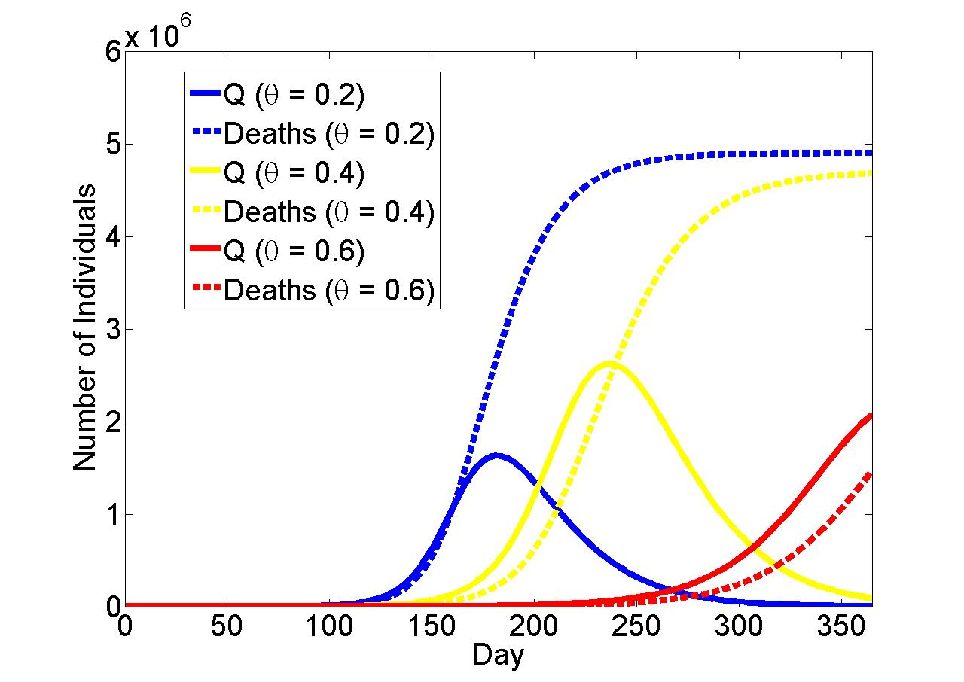
Efficacy of quarantine
Increasing quarantine rates reduces the number of deaths
Model could be used to look at resource constraints, cost-effectiveness (number quarantined per case averted) etc.

Slide 11
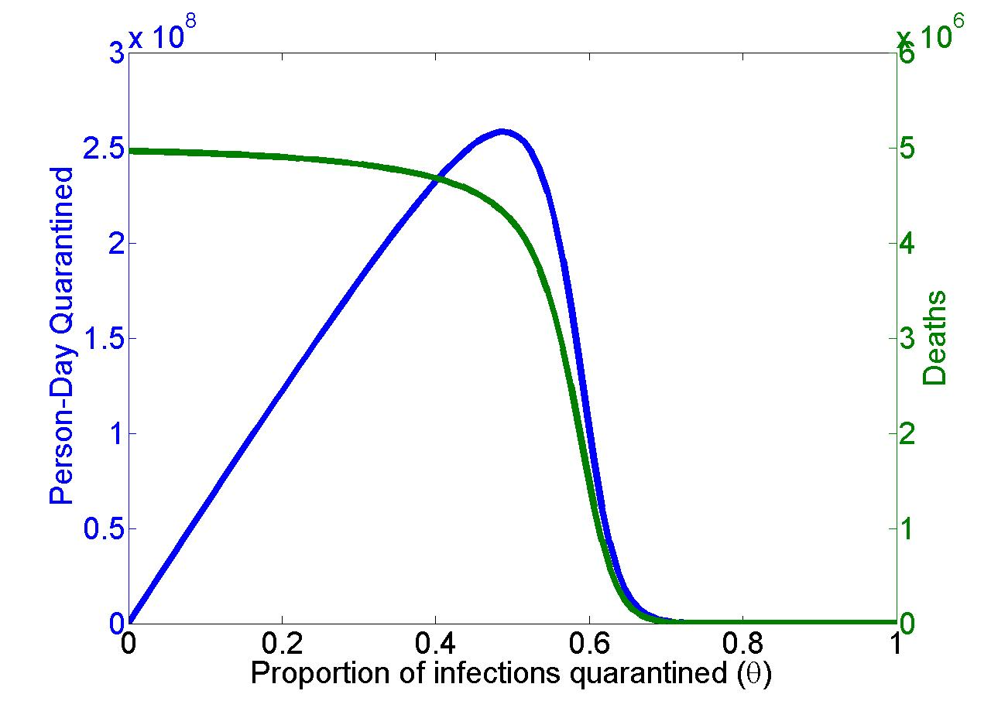
Cost and benefit of quarantine
Person-day quarantined: If X_{t} people are quarantined on day t, then
the person-day quarantined on day t is X_{t}. The total person-day quarantined from day 1 and day n is then X₁+X₂+… +X_{n-1}+X_{n}.
Day 365

Slide 12
Quarantining contacts of infectious persons
S
E
I
U
S
E_{n}
I
U
λ
α
γ
(1−ρ)λ
(1−θ)α
γ
ρβ(1−φ)I
χ₂
ρλ
θα
χ₁
Q
α
C_{i}
E_{i}
ρ = proportion of contacts that are traced
χ₁ = rate of release from quarantine for uninfected contacts = 1/(mean duration of quarantine for contacts)
E_{n} = number of contacts who are untraced but latent
E_{i} = number of contacts who are traced and latent
C_{i} = number of contacts who traced but uninfected

Slide 13
Quarantining contacts of infectious persons
S
E
I
U
S
E_{n}
I
U
λ
α
γ
(1−ρ)λ
(1−θ)α
γ
ρβ(1−φ)I
χ₂
ρλ
θα
χ₁
Q
α
C_{i}
E_{i}

Slide 14
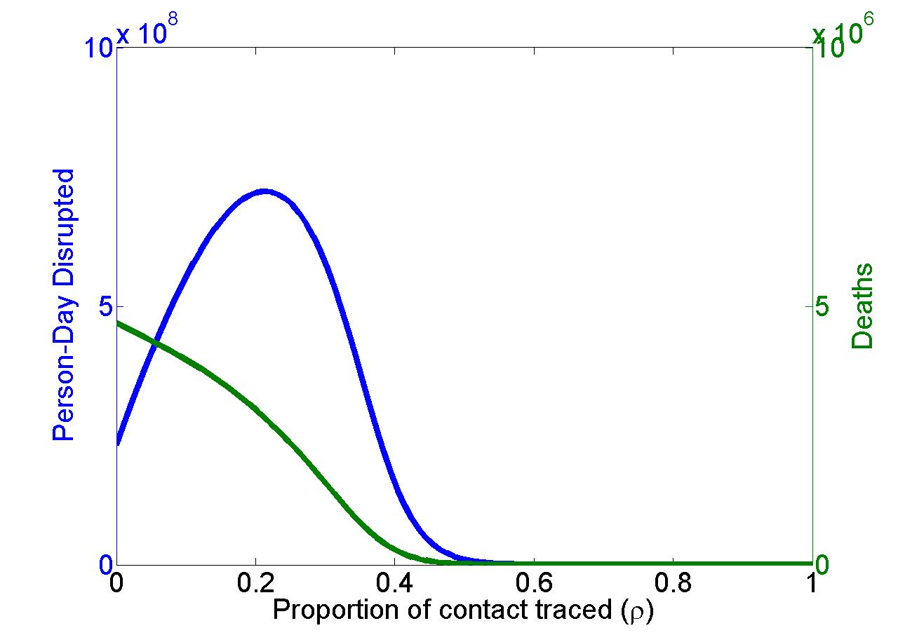
Impact of contact tracing and quarantine
θ = 0.4 (θ = 0.95 in the article)

Slide 15
Vaccinating contacts of infectious persons
(1−ρ)λ
S
E
I
U
S
E_{n}
I
U
λ
α
γ
(1−θ)α
γ
ρβ(1−φ)I
ρλ
θα
χ₂
Q
χ₁(1−ε₁)
α(1−ε₂)
C_{i}
E_{i}
χ₁ε₂
χ₁ε₁
V
ε₁ = vaccine efficacy in uninfected (probability of complete protection)
ε₂ = vaccine efficacy in infected (probability of complete protection)

Slide 16
Vaccinating contacts of infectious persons
(1−ρ)λ
S
E
I
U
S
E_{n}
I
U
λ
α
γ
(1−θ)α
γ
ρβ(1−φ)I
ρλ
θα
χ₂
Q
χ₁(1−ε₁)
α(1−ε₂)
C_{i}
E_{i}
χ₁ε₂
χ₁ε₁
V

Slide 17
Readings
Panagiotopoulos, T. et al., 1999. Increase in congenital rubella occurrence after immunisation in Greece: retrospective survey and systematic review. BMJ (Clinical research ed.), 319(7223), pp.1462-7.
Vynnycky, E., Gay, N. J., & Cutts, F. (2003). The predicted impact of private sector MMR vaccination on the burden of Congenital Rubella Syndrome. Vaccine, 21(21-22), 2708-2719.
Gani R, Leach S (2001) Transmission potential of smallpox in contemporary populations. Nature 414: 748-751.

